Slide 1
Committee Meeting 1
Emma Timmins-Schiffman
May 21, 2010

Slide 2
Outline
Guiding Themes of Research
Title & Objectives
Objective 1 Approaches
Objective 2 Approaches
Objective 3 Approaches
Accomplishments to Date
Future Perspectives

Slide 3
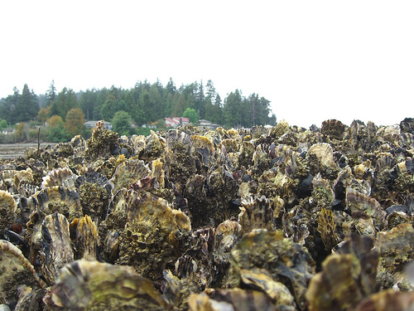
Guiding Themes of Research
How do environmental changes affect populations?
  Organism perspective: changes in physiology
  Long-term perspective: changes in population dynamics & genetics
Focus on the model organism Pacific oyster, Crassostrea gigas

Slide 4
Outline
Guiding Themes of Research
Title & Objectives
Objective 1 Approaches
Objective 2 Approaches
Objective 3 Approaches
Accomplishments to Date
Future Perspectives

Slide 5
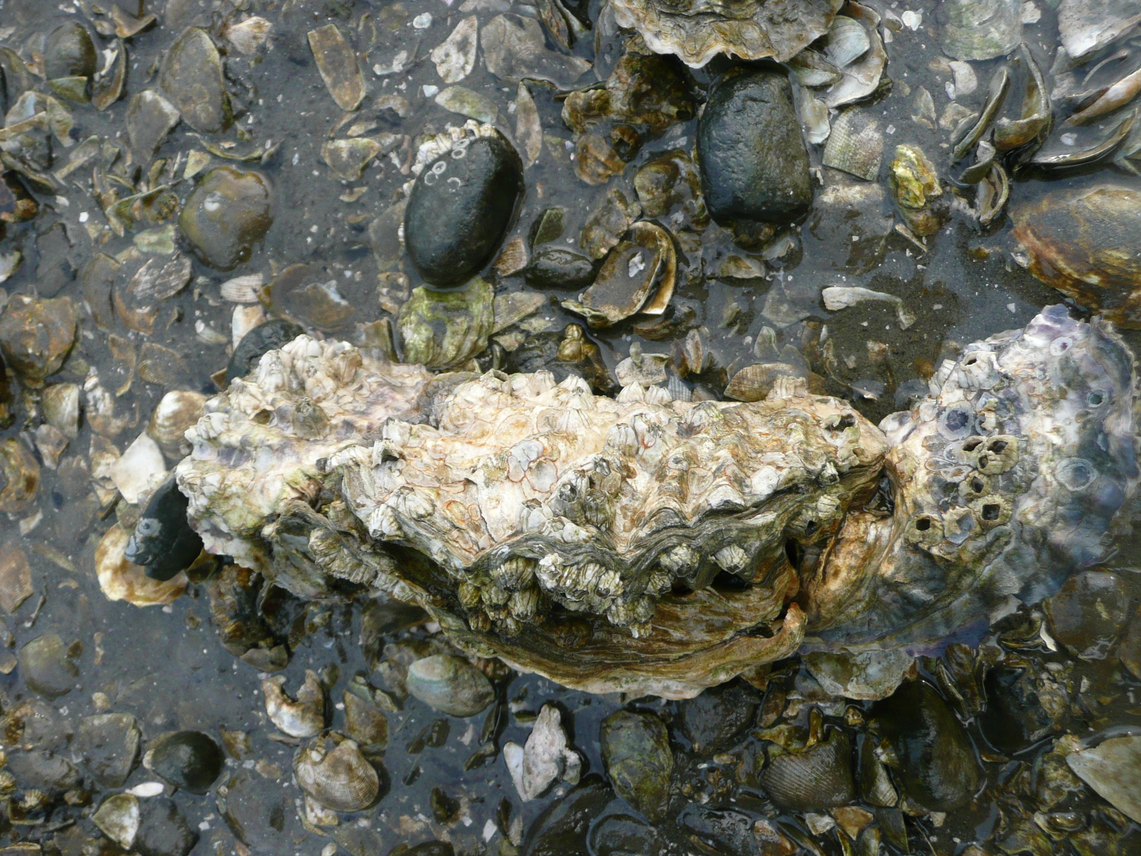
Title
The Effects of Human-mediated Environmental Change on the Physiology of the Pacific Oyster, Crassostrea gigas: Immediate & Long-term Perspectives

Slide 6
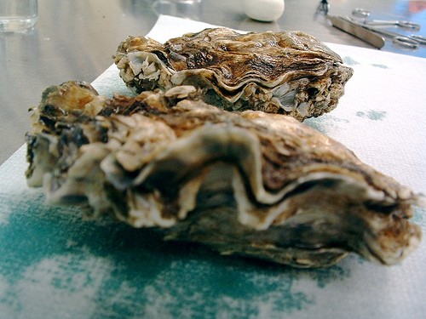
Objective 1
Characterize the physiological response of bivalves to stressors of environmental change.
  Laboratory trials

Slide 7
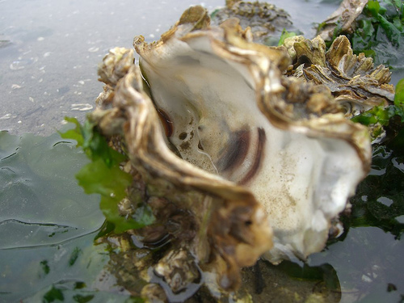
Objective 2
Assay the effects of local environmental parameters and contaminants on wild sets of C. gigas.
  Environmental sampling
  Apply results from 1 + gene discovery

Slide 8
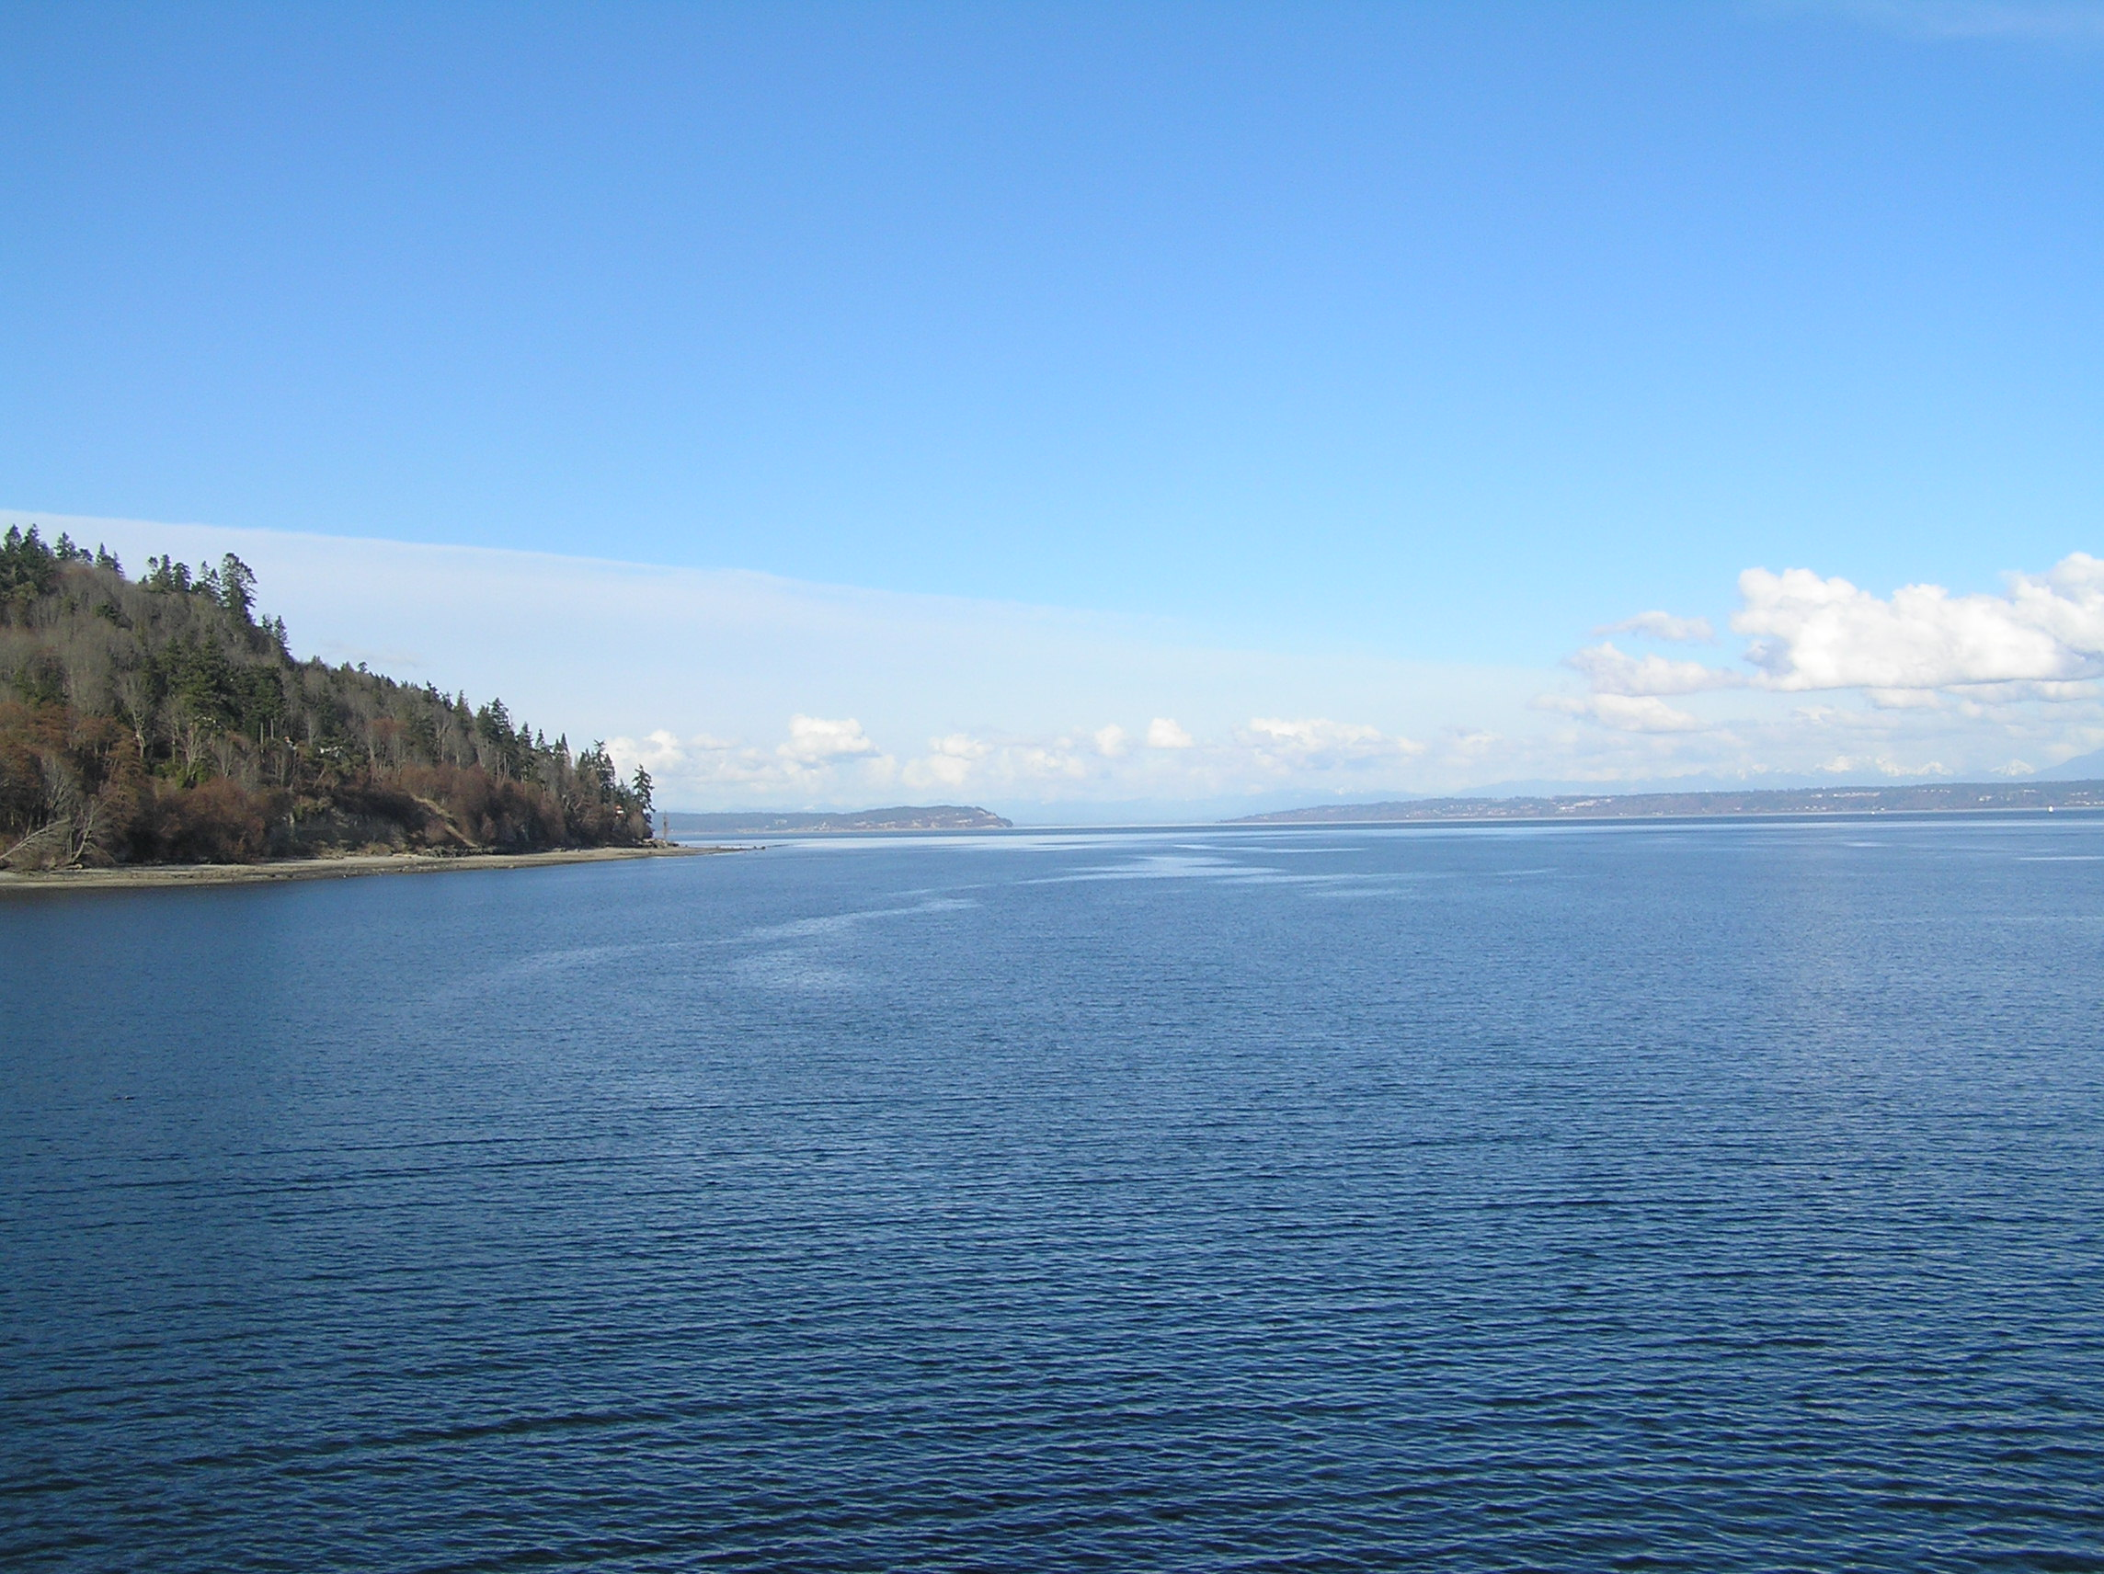
Objective 3
Determine the population genetic resources available for potential adaptation to environmental change.
  Discover adaption-correlated SNPs

Slide 9
Outline
Guiding Themes of Research
Title & Objectives
Objective 1 Approaches
Objective 2 Approaches
Objective 3 Approaches
Accomplishments to Date
Future Perspectives

Slide 10
Objective 1: Characterize the physiological response of bivalves to stressors of environmental change.

Slide 11
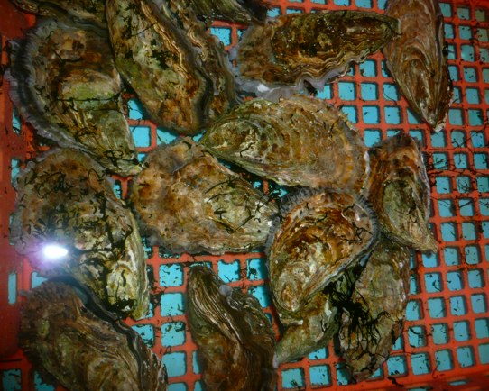
Objective 1 Approaches
What causes hatchery mortality events?
How do oysters respond physiologically to environmental stress?
How do changes in the environment affect the host-pathogen relationship?
Develop a predictive assay of markers indicative of individual and multiple stressors.
Notes:
Focus will be mainly on laboratory trials. Will measure: gene expression, mortality, & behavior

Slide 12
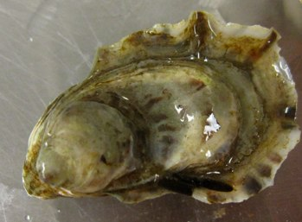
Objective 1 Approaches
Temp.
Pathogen
pH
Laboratory trials
  Single -> dual -> multiple stressors
  Host only (larvae) & host + pathogen (Vibrio tubiashii)
pH: 380 & 840 pCO2
Temperature: 12C & 25C
Stages of development: D-hinge, veliger, pediveliger
Metal
Notes:
Better understand impacts of MULTIPLE stressors

Slide 13
Objective 1 Approaches
Challenges
  2 weeks each – get larvae & algae from hatchery before each trial period
5/31: grow larvae with algae – sample for baseline
6/7: CO₂ challenges
6/21: CO₂ + Vt challenges
7/5: metal bioavailability
FHL: pathogen + CO₂ + temperature
Notes:
To feed: Isochrysis (T-Iso), diatom, Tetraselmis
Undergrad research: find LD50 of Vt and gigas larvae

Slide 14
Objective 1 Approaches
Sampling protocol
  4-8 chambers per treatment
  2 draws of larvae each day from each chamber
  ~50-200 larvae for each draw (sample 100-400/day per chamber)
Sample 11,200-44,800 larvae per treatment period
Need at least 50,000 larvae every 2 weeks

Slide 15
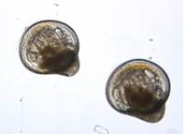
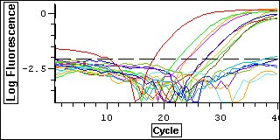
Objective 1 Approaches
Measuring the effects of the treatments on oyster larvae
  Gene expression
  Mortality
  Behavior
Results will provide information on lethal and non-lethal effects of stressors

Slide 16
Objective 1 Approaches
Gene expression
  Determine impacted physiological pathways
  Develop assays for future applications
Methods
  Targeted genes
  Differential display
  General stress: Western blot
Notes:
Physiological pathways = nonlethal effects

Slide 17
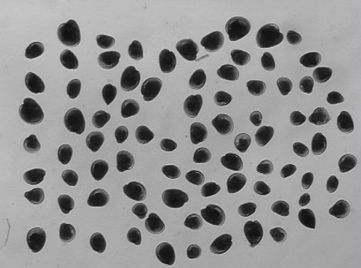
Objective 1 Approaches
Behavior
  Settlement – shell in bottom of chamber
  Development time
  Shell dissolution
  Lipid content – effects on nutrition
Miller et al. 2009
Notes:
Shell dissolution: SEM? Quantify CaCO3 in shell? Miller et al. 2009 digital image -> dissolve & quantify Ca
Lipids: extract lipid & quantify gravimetrically; or can stain & quantify

Slide 18
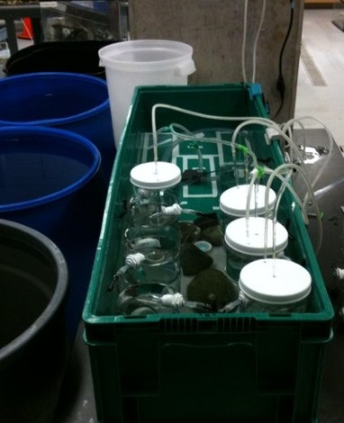
Objective 1 Approaches
Intra-system microbial community
  1 mL water from each chamber each day
  Filter out larvae
  Vacuum filter sample
Extract DNA & PCR for specific pathogens

Slide 19
Objective 2: Assay the effects of local environmental parameters and contaminants on wild sets of C. gigas.

Slide 20
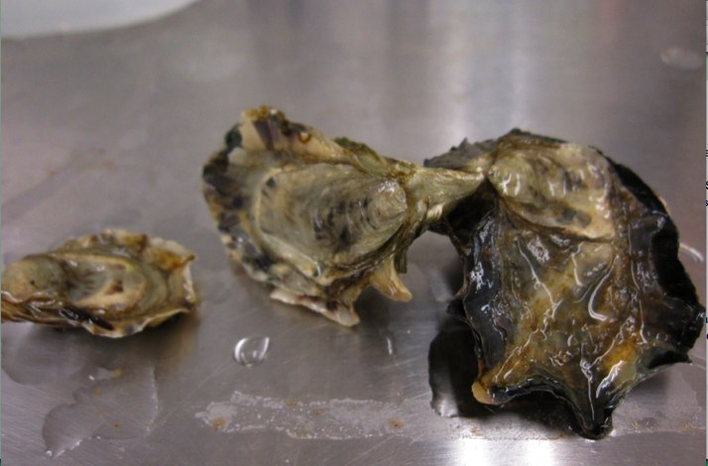
Objective 2 Approaches
How is larval response different inside the hatchery?
Are there different stresses and responses around Puget Sound?
  How does this affect oyster phenotype?

Slide 21
Objective 2 Approaches
Hatchery sampling
  Oyster larvae (C. gigas)
  Microbial community
Puget Sound sampling
  Sibling juveniles (C. gigas)
  Passive sampling devices

Slide 22
Objective 2 Approaches
Hatchery sampling – what are the oyster larvae experiencing now?
  Early spring-summer, 2 years
  Netarts, OR & Quilcene, WA (hatcheries)
  Netarts Bay & Dabob Bay (field)
  Inside vs. outside hatchery
Metrics
  Candidate genes (assay) & Western blot
  Environment: salinity, temperature, alkalinity & DIC, V. tubiashii
  Settlement (spat collectors at Taylor?)
Notes:
Weather station data at hatchery? Environmental data from last year? What is protocol for spat collectors?
Archived samples: Larval sampling weekly or semi-weekly. Preserve in RNA later. If something happens, if anomalous environment, can correlate with archived samples. Complemented by archived microbial ARISA.

Slide 23
Objective 2 Approaches
Details of hatchery oyster sampling
  Outside (weekly)
    Pump near water intake
    Salinity, T, pCO2, pH, plankton, V. tubiashii
  Inside (weekly)
    Oyster larvae tanks (2 reps per tank, 3 tanks)
    T, alkalinity, DIC, salinity, V. tubiashii
Complementary data from Netarts for comparison?
Notes:
Need spawn date for larvae

Slide 24
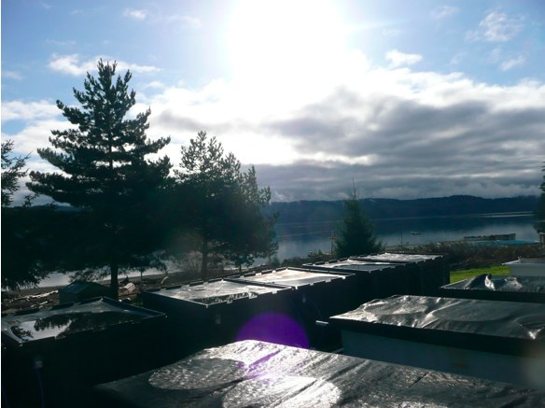
Objective 2 Approaches
Environmental sampling of microbial communities at Quilcene hatchery (weekly)
  Sample at locations inside and outside of hatchery
Use ARISAs to characterize microbial community structure
  How is it affected by different environmental conditions?
  Are there predictors of mortality events?
Notes:
Ralph & Ildiko do not sample outside hatchery, but do weekly inside sampling

Slide 25
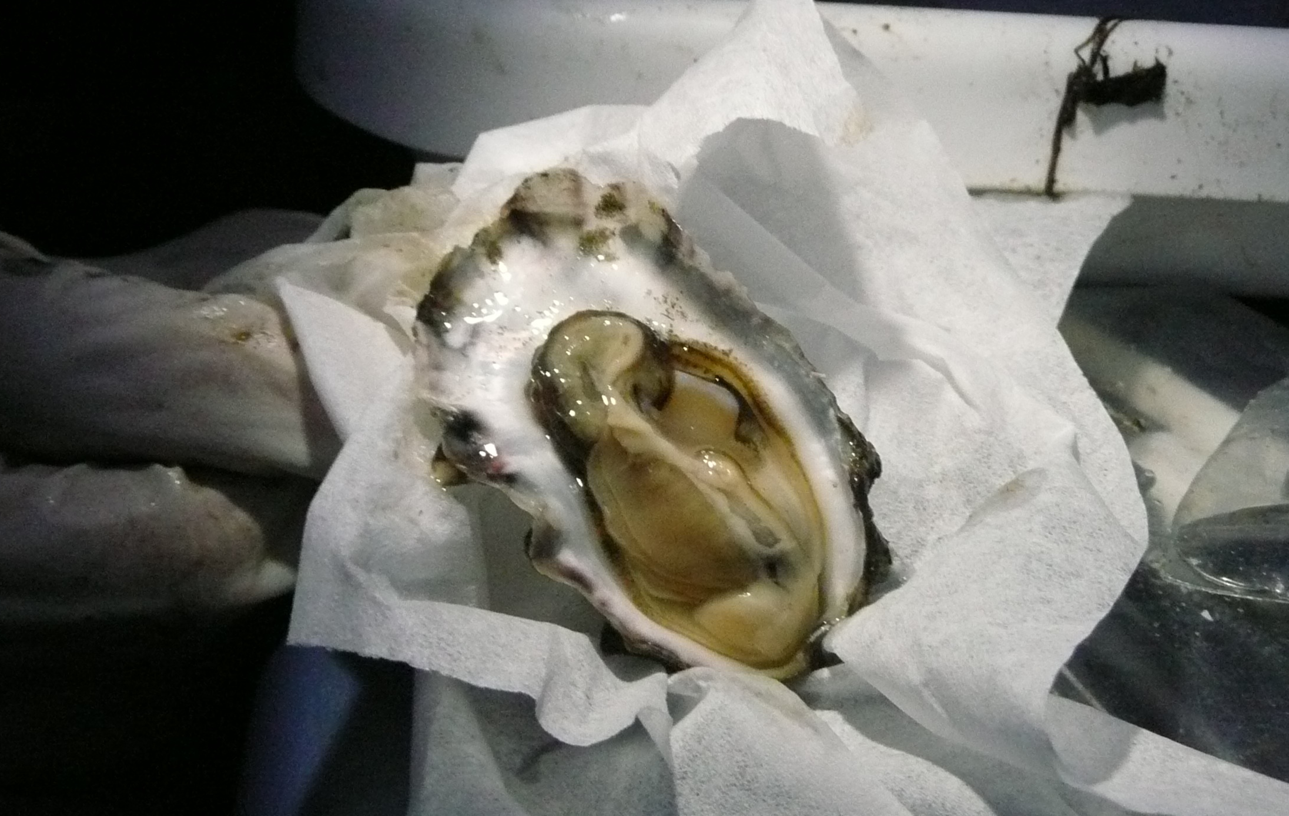
Objective 2 Approaches
Lab data + environment data -> oyster response to environmental stress
Specific impacts – which stressors are responsible?
Oyster as proxy for ecosystem health

Slide 26
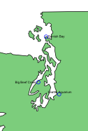
Objective 2 Approaches
Semi-monthly sampling of 3 sites in Puget Sound with different human impact levels
  C. gigas sibling juveniles
Sampling scheme
  Gills – gene expression & epigenetics
  Hemocytes – immune response
  Growth & mortality
Notes:
How does the environment affect phenotype?
Ensure immersion time is the same for sampling
Measure lipid content?
What can Oceanography do?

Slide 27
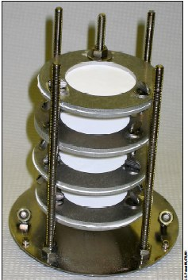
Objective 2 Approaches
Monitor contaminants at sampling sites
Use passive sampling devices (2 kinds that collect complementary data)
Measure:
  Pharmaceuticals
  Personal care products
  POPs
Deploy at sampling sites
  Change devices every month
Results: Which contaminants are the most problematic for oyster & ecosystem health?

Slide 28
Objective 3: Determine the population genetic resources available for potential adaptation to environmental change.

Slide 29
Objective 3 Approaches
Are there genotypes linked to potential for adaptation in climate change?
How will current and future change affect Ne and other population genetic parameters?
How does environmental change modify the genetic profile of populations?
Are there inter-species differences in potential for adaptation?

Slide 30
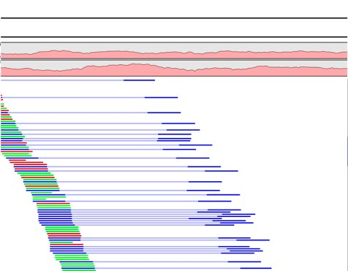
Objective 3 Approaches
During laboratory stress trials, sample pre- and post-trial larvae
Find SNPs using existing NGS data
  Which SNPs are consistently different between mortalities & survivors?
  Are the SNPs associated with any genes?
Notes:
Stress trials: 1. just CO2 2. CO2-T-pathogen
Sufficient genetic diversity can mimic evolutionary time – what is spawning plan at hatchery?
Make primers from cDNA -> verify amplify one product of DNA -> RAD or HRM to see what is different (or SNP chip) -> genotype using HRM -> different proportions of genotypes in pre vs. post challenge

Slide 31
Objective 3 Approaches
Links to Objective 1
  Same larvae used for physiology analysis – genotype-phenotype link
Genetic diversity in survivors
  Does environmental change create a bottleneck?
Do different SNPs have a functional significance at the population level?
Environment
N
Ne

Slide 32
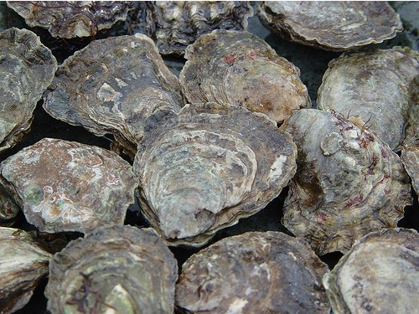
Objective 3 Approaches
Olympia oysters, Ostrea lurida
  Wild population
  Inter-species difference in environmental response
Distribution of SNPs throughout Puget Sound area
  Sample wild larvae: 2 locations, twice during season
  Same challenge trials as C. gigas
  Use NGS to find SNPs

Slide 33
Outline
Guiding Themes of Research
Title & Objectives
Objective 1 Approaches
Objective 2 Approaches
Objective 3 Approaches
Accomplishments to Date
Future Perspectives

Slide 34
Accomplishments to Date
Stress trials of C. gigas
  Juvenile & adult C. gigas and elevated CO2 and V. tubiashii presence
  Juveniles challenged with V. tubiashii
  Juveniles challenged with copper nitrate
  Maintain larvae in experimental larval chambers

Slide 35
Accomplishments to Date
Adult & juvenile C. gigas
350ppm
970 ppm
Control CO₂, no disease
+ V. tubiashii
+ V. tubiashii
High CO₂, no disease
Adults: n=8
Juveniles: n=16
Adults: n=8
Juveniles: n=16
Adults: n=8
Juveniles: n=8
Adults: n=8
Juveniles: n=8

Slide 36
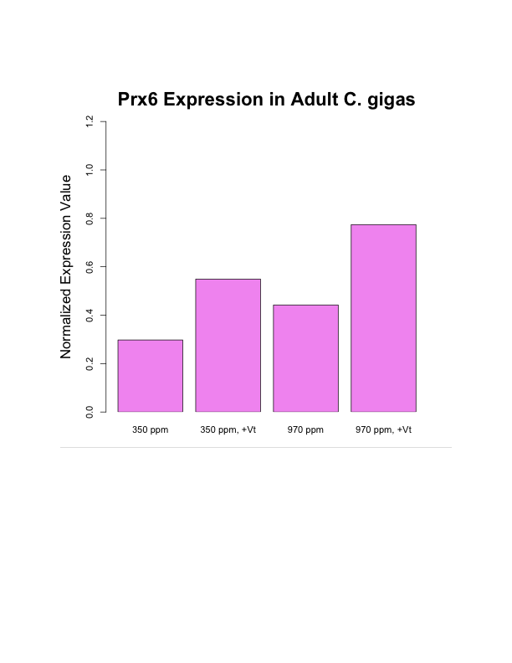
Preliminary Results
Up-regulation of Prx6 to elevated CO2 and to secondary stress of V. tubiashii.

Slide 37
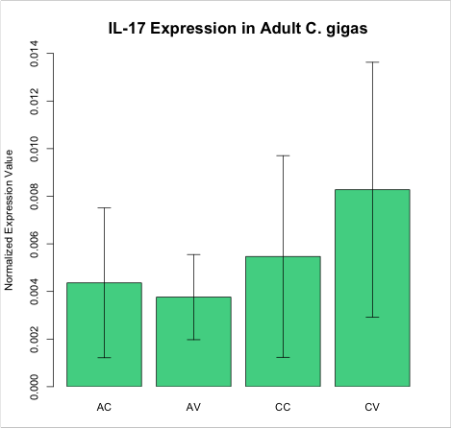
Preliminary Results
Up-regulation of IL-17 in exposure to elevated CO2 and secondary stressor V. tubiashii.

Slide 38
Differential Display: Response to CO₂
Primer Set | blastx | EST
10 | TGF-B-inducible nuclear protein
12 (200 bp) | Chaperonin subunit | Cg in temp. stress
38 | NADH dehydrogenase | Cg
18 | Beta-tubulin | Oyster stress
9 | Matrilin (ECM) | Oyster stress

Slide 39
Response to V. tubiashii
Juvenile C. gigas challenged with bacteria for 3 hours.

Slide 40
GO from Sigenae & SwissProt: metal binding
n = 470

Slide 41
Genes of Interest
Thioredoxin reductase: thioredoxin reductase, glutaredoxin and gluathione reductase activities. Catalyzes disulfide bond isomerization.
Fatty acid desaturase: catalyzes biosynthesis of highly unsaturated fatty acids.
mRNA decapping enzyme: degradation of mRNA in turnover and decay.
Hematopoietic prostaglandin D synthase: implicated in smooth muscle function & exhibits low glutathione peroxidase activity.
Copper-transporting ATPase: in copper excess, functions in efflux of copper from cells.

Slide 42
Outline
Guiding Themes of Research
Title & Objectives
Objective 1 Approaches
Objective 2 Approaches
Objective 3 Approaches
Accomplishments to Date
Future Perspectives

Slide 43
Timeline
 |  | 2010 |  |  |  |  |  |  |  | 2011 |  |  |  |  |  |  |  |  |  |  |  | 2012 |  |  |  |  |  |  |  |  |  |  |  | 2013 |  |  |  |  |  |  |  |  |  |  |  | 2014
 |  | May | June | July | Aug | Sept | Oct | Nov | Dec | Jan | Feb | March | April | May | June | July | Aug | Sept | Oct | Nov | Dec | Jan | Feb | March | April | May | June | July | Aug | Sept | Oct | Nov | Dec | Jan | Feb | March | April | May | June | July | Aug | Sept | Oct | Nov | Dec | Jan | Feb | March | April | May
Obj 1 | C. gigas larval challenges
 | RNA Extraction & qPCR (& DNA Obj 3)
 | Gene Expression Analysis
 | Behavior Analysis
 | Microbial DNA Extraction & PCR
 | Analysis of Microbial Results
 | Write Paper on Cg Physiology
Obj 2 | Hatchery larvae sampling
 | RNA Extraction & qPCR
 | Analysis of qPCR
 | Analysis of Environment-Physiology
 | Hatchery micribial community sampling
 | ARISAs & Analysis
 | Puget Sound outplanted juvenile sampling & PSDs
 | Juvenile RNA extraction & qPCR
 | Analysis of juvenile qPCR
 | Analysis of PSD results
 | Write Paper on larvae-envt-microbe
 | Write Paper on contaminants & oysters
Obj 3 | Find SNPs for C. gigas & make primers
 | SNP Genotyping & Analysis
 | Sample wild O. lurida larvae
 | O. lurida larval challenges
 | NGS of O. lurida
 | O. lurida SNP analysis
 | Write paper on adaptive SNPs in C. gigas
 | Write paper on SNPs O. lurida vs. C. gigas
 | SISG
 | FHL
 | Write Dissertation

Slide 44
Short-term Goals
Establish regular sampling procedure
  Outplant juvenile sibling C. gigas week of September 6, 2010
Begin stress trials
  Trouble-shoot system
  Feasibility of multiple stressors
  Get larvae, grow food
Design project for FHL
Grants!!

Slide 45
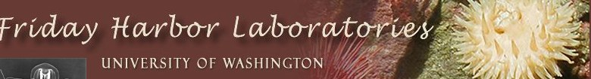




Plan of Study
Completed courses
  Stats
  Histology of Disease
  Integrative Environmental Physiology
  Proposal Writing
  Literature seminar
  R Programming
Intended courses
  Climate Science seminar
  Multivariate statistics
  FHL
  SISG
  Genomics
  Population genetics
  Statistics for genome sciences

